Slide 1
Engaging Students
CCAC
Elizabeth Claytor, MA, ABD
August 17, 2022

Slide 2
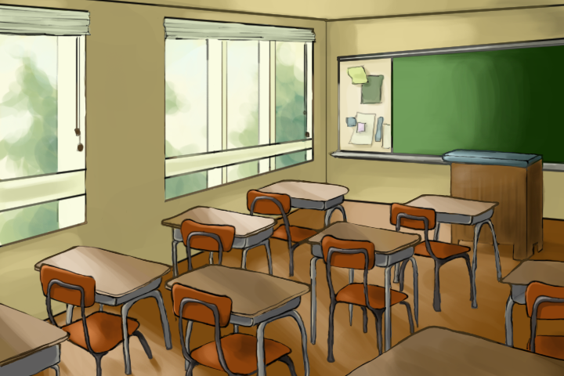
Identify the Problem
Students are reluctant to speak and share ideas in the classroom setting.
Notes:
Reluctance because of shyness, fear of saying something wrong, or uninterested in the discussion topic.

Slide 3
Notes:
Zoom has its own individual problems as well. Cameras and audio are often turned off.

Slide 4
Learning and Behavioral Objectives
Read, write, and speak critically, learn to summarize, analyze, interpret, and evaluate relevant information from a variety of print and electronic sources, as well as from direct observation, interviews and surveys.
Notes:
Students do not know what to expect in a writing course. They are often surprised that some reading and speaking is crucial components of a composition course.

Slide 5
Teaching Task: Create and Teach a Strategic Plan

Slide 6
Work the Plan
1. Present a short piece of reading or a writing prompt. 2. Each group will choose a recorder and a reporter. 3. The recorder will gather all group member names and create a Word document with their group’s responses. The recorder will upload the notes to Blackboard.

Slide 7
Work the Plan
4. 20 minutes will be devoted to discussion and writing. 5. FEEDBACK: 15-20 minutes will be used for Reporters will share the highlights of the discussions. Other are invited to respond and share their thoughts. 6. Assign learners to break out rooms

Slide 8
Make It Work

Slide 9
Repetition

Slide 10
Discussion Guidelines 1. Demonstrate that you understand the prompt. 2. Make relevant comments. 3. All group members should contribute.

Slide 11
MLA Composition Standards
Mechanics of Writing:
Use the correct heading
Today's date: 17 August 2022
Double spaced text
Times New Roman -12 point font
Minimum: one paragraph (7-12 sentences)
Correctly written and punctuated sentences

Slide 12
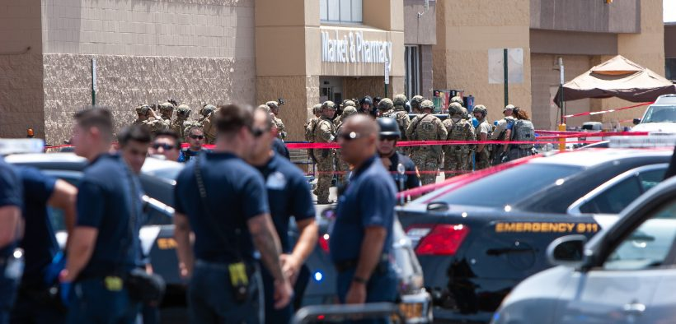
Initial Assignment
In-Class Writing
Think about current events. What is happening in the world today that interests, concerns, amuses, surprises, or inspires you?
Write at least a one-paragraph to expand on your chosen topic.
Suggestions/Examples:
time change - Daylight Saving Time
war in Ukraine
gasoline prices
covid-19
current movies - Ryan Reynolds' movies
spring is coming
food choices
food prices/shortages

Slide 13
Example Prompt
In-Class Writing:
The Slap Heard Around the World
Will Smith and Chris Rock are trending on social media. At the Oscars program on Sunday, Chris Rock made a joke about Will Smith's wife. Smith went onto the stage and slapped Chris Rock. He returned to his seat in the audience and told Rock to keep his wife's name out of his mouth.
Your opinion is requested. Was Will Smith's behavior all right with you? Was it wrong? Why? Should Will Smith be punished? Explain your answer.

Slide 14
Example Prompt
For the fall 2022 semester, all CCAC students enrolled in face-to-face classes or participating in sports or campus activities must be vaccinated and provide proof of vaccination. What is your response to this new policy? How will it affect you? Offer your reaction and explain your response.

Slide 15
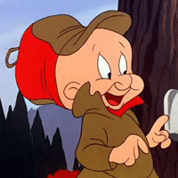
That’s All Folks!
(Or the End of the Beginning)
Notes:
Elmer says, That’s all folks!!!!” My favorite cartoon guy.
Image Source: Creative Commons

